Slide 1
ChIP-sequencing: Library preparation and experimental design
Stéphanie Le Gras
(slegras@igbmc.fr)

Slide 2
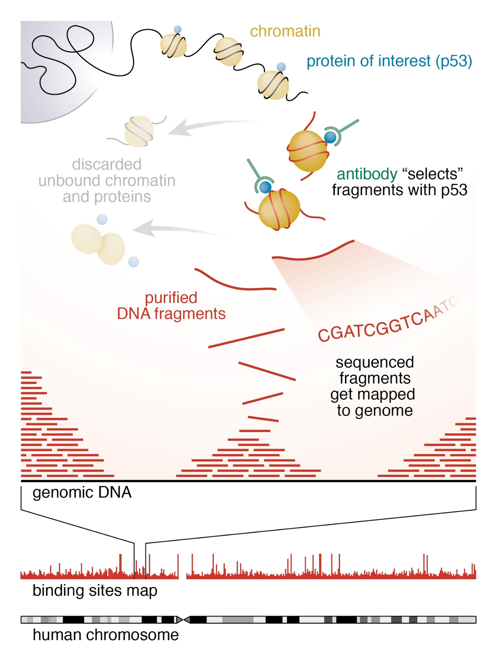
ChIP-seq
Johnson et al, 2007
Alternative to ChIP-on-chip (hybridization technique)
ChIP-seq combines chromatin
immunoprecipitation and sequencing to
analyze protein interactions with DNA
It can be used to detect and analyze
Binding sites of various proteins bound to DNA such as transcription factors (TF ChIP-seq)
Position of histone post translational
modifications (Histone ChIP-seq)
Nucleotide modification such as methylation (MeDIP-seq)
Expected results of a ChIP-seq experiment are
genomic regions with significant sequenced
read enrichments (also called peaks)
https://hbctraining.github.io/Intro-to- ChIPseq/lessons/01_Intro_chipseq_data_organization.html

Slide 3
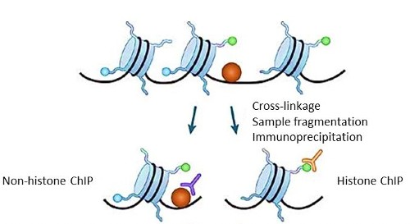
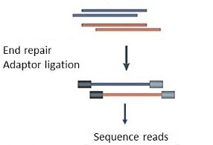
ChIP-seq process
Library prep and sequencing
ChIP
Data analysis

Slide 4
Chromatin ImmunoPrecipitation
Library prep and sequencing
ChIP
Data analysis

Slide 5
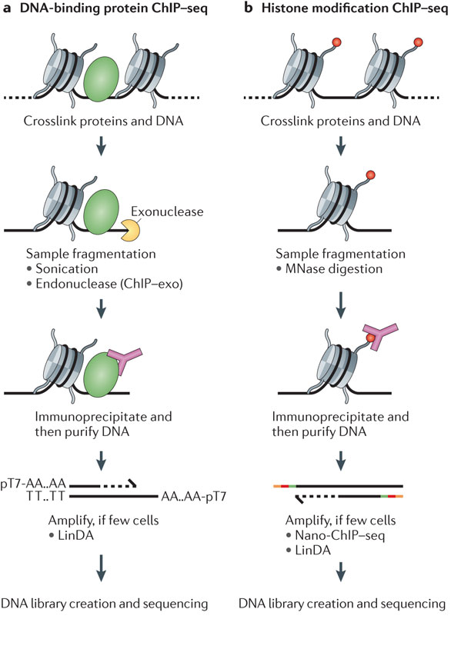
Chromatin ImmunoPrecipitation
Nature Reviews Genetics 13, 840-852 (December 2012) doi:10.1038/nrg3306

Slide 6
Considerations on chIP
Complexity in DNA fragments ++
Antibody
Antibody quality varies, even between independently prepared lots of the same antibody (Egelhofer, T. A. et al. 2011)
Number of cells
large number of cells are required for a ChIP experiment (limitation for small organisms)
Nano-ChIP–seq (Adli et al, 2011)
LinDA (Shankaranarayanan et al, 2011)
Cut&tag, Cut&run
Shearing of DNA (Mnase I, sonication, Covaris): trying to narrow down the size distribution of DNA fragments

Slide 7
Cut&Run, Cut&tag

Slide 8
Library prep and sequencing
Library prep and sequencing
ChIP
Data analysis

Slide 9
Library prep
Step between chIP and sequencing
The goal is to prepare DNA for the sequencing
Starting material:
2-10ng of sheared DNA (Purification using Agencourt AMPure XP - Beckman Coulter)
The mean DNA fragment size should be below 500bp (Smear in a range of 100 to 700)
ChIP
Ligation of adapters
Size selection (200 or 600 bp)
PCR amplification
Single-end Sequencing Paired-end Sequencing
Notes:
Pas de purification entre les étapes. Adaptateurs avec une forme en boucle (evite dimer d’adaptateurs)
Size selection: bille amPure (Beckman). Ratio 1 pour 1. Volume à Volume. -> > à 200bp.

Slide 10
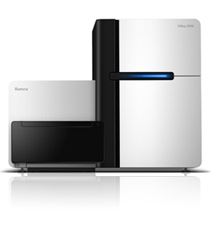
Sequencing
Sequencer : Illumina HiSeq 4000
No. of reads per run, per sample :
HiSeq 4000: 300-350 millions reads per lane
Multiplexing 8 samples per lane :~43 millions per sample
Length of DNA fragment : ~200-600bp
No. of cycle per run : 50

Slide 11
Single end or paired end?
Single end (most of the time)
Paired-end sequencing
Improve identification of duplicated reads
Better estimation of the fragment size distribution
Increase the mapping efficiency to repeat regions
The price!

Slide 12
Sequencing depth
Consider the depth needed depending on:
chipped protein,

Slide 13
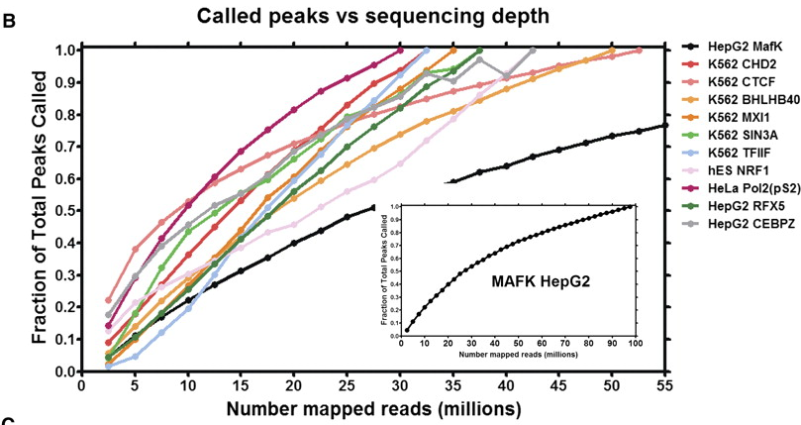
Sequencing depth
Landt et al, 2012

Slide 14
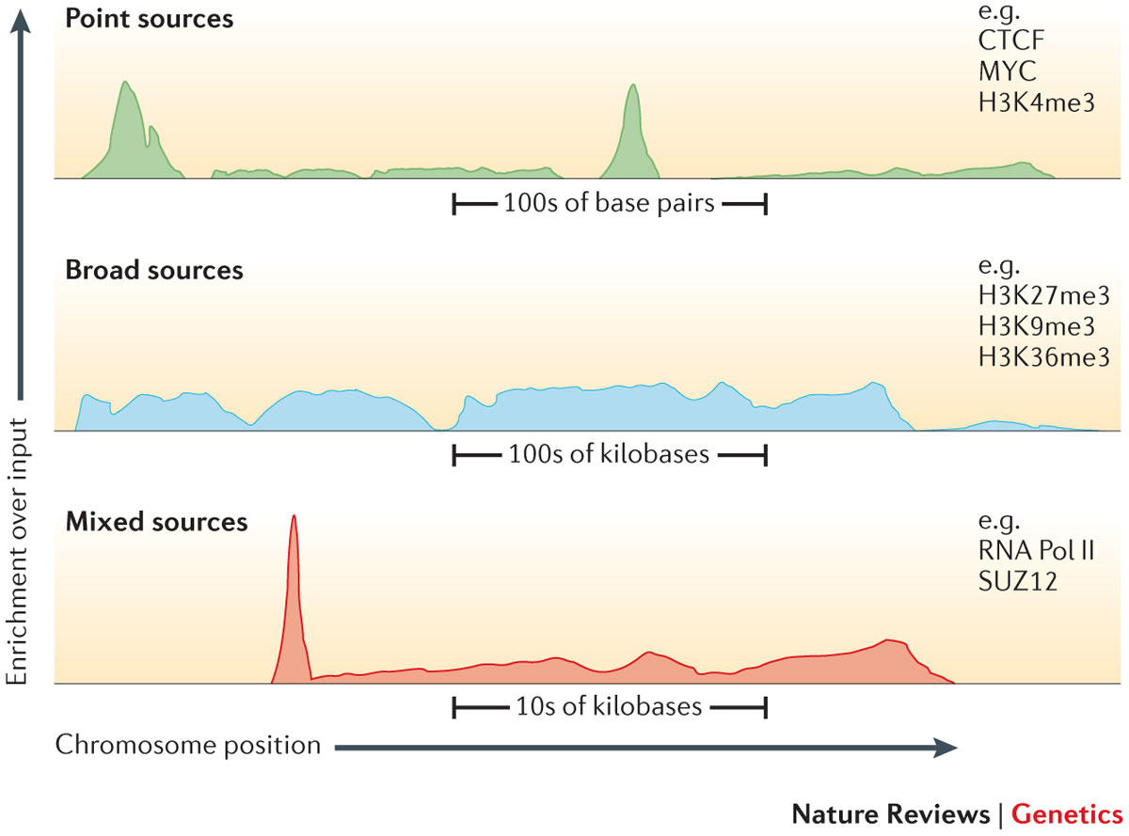
Sequencing depth
Consider the depth needed depending on:
chipped protein,
type of expected profile,
number of expected binding sites,
size of the genome of interest.
Ex:
For human genomes, 20 million uniquely mapped read sequences are suggested for point-source peaks, or 40 million for broad-source peaks.
For fly genome: 8 million reads
For worm genome: 10 million reads

Slide 15
Control sample
Problem:
Only a fraction of sequenced reads corresponds to true signal (DNA fragments specifically selected during ChIP). Non-specific enrichment is called background.
We want to extract regions in the genome that are specifically bound by the protein of interest
and not due to some experimental artefacts.
Solution:
In addition to chipped samples, control samples are also generated and sequenced. Control
samples don’t undergo specific immunoprecipitation thus read enrichments they might exhibit,
are non specific. By comparing chipped to control samples, regions showing read enrichment both
in control and chipped samples might be false positive enrichments and thus not retained as true peak.
3 types of control are commonly used :
Input DNA : a portion of DNA sample removed prior to IP
DNA from non specific IP : DNA obtained from IP with an antibody not known to be involved in DNA binding or chromatin modification such as IgG
Mock IP DNA : DNA obtained from IP without antibodies

Slide 16
Replicates
A minimum of two replicates should be carried out per experiment.
Each replicate should be a biological rather than a technical replicate; that is, it represents an independent cell culture, embryo pool or tissue sample.

Slide 17
ENCODE
The Encyclopedia of DNA Elements (ENCODE) Consortium has carried out hundreds of ChIP–seq experiments and has used this experience to develop a set of working standards and guidelines
See: https://www.encodeproject.org/about/experiment-guidelines/

Slide 18
Data used in this course
Sample name | No. of raw reads
MITF | 31,334,257
Ctrl | 29,433,042
H3K4me3 | 11,192,622
polII | 10,404,820

